Slide 1
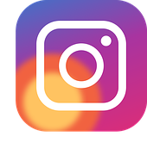

INSTAGRAM USER ENGAGEMENT ANALYSIS
LEVERAGING USER DATA FOR GROWTH, RETENTION AND MARKET SUCCESS
BY – ANIKET ARVIND BANTE
DATE – 26/10/2026

Slide 2

AGENDA Business Problem Data Overview Data Quality Assessment User Activity Analysis Engagement Analysis Influencer & Ambassador Identification Content Performance Marketing Strategies Recommendations Conclusion

Slide 3

ABOUT META
Meta, formerly known as Facebook, is a technology company founded by Mark Zuckerberg in 2004. It rebranded to Meta in October 2021 to emphasize its focus on building the "metaverse," a virtual reality space where users can interact in a shared, immersive environment. Meta's ecosystem includes social media platforms like Facebook, Instagram, and WhatsApp, as well as technologies for augmented and virtual reality, such as Oculus. The company's vision is to create a new digital frontier where people can connect, work, and play in virtual worlds that blend seamlessly with the physical world.

Slide 4
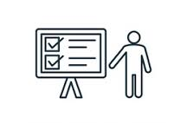
PROBLEM STATEMENT
You are hired as a data analyst at Meta and asked to collaborate with the Marketing team. Marketing teams want to leverage Instagram's user data to develop targeted marketing strategies that will increase user engagement, retention, and acquisition. Provide insights and recommendations to address the following objectives.

Slide 5
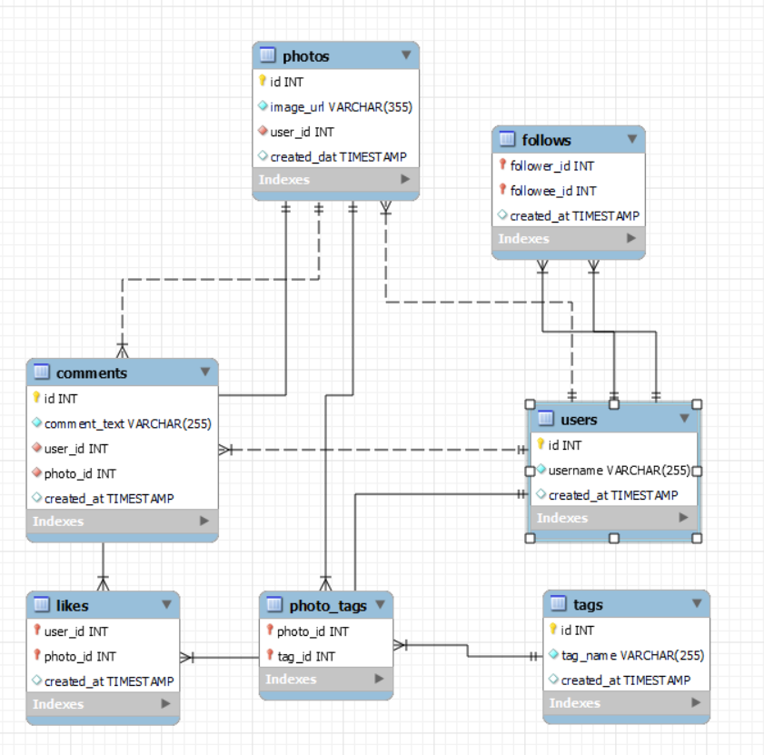
DATA DESCRIPTION
comments_id : unique identifier for each comment
comment_text : text content of a given comment
user_id : unique identifier for each user
photo_id : unique identifier for each photo
created_at : date of interaction in the form like, photos, tags
follower_id : user_id of the follower for a certain user
followee_id : user_id of followee for a certain user
tag_id : unique identifier for each tag
image_url : link to the image posted on the platform
username : username chosen by the user

Slide 6
ANALYTICAL APPROACH
DATA CLEANING
DUPLICATE AND NALL VALIDATION
EXPLORATORY DATA ANALYSIS
SQL ANALYSIS
USER SEGMENTATION
CONTENT PERFORMANCE ANALYSIS
STRATEGY DEVELOPMENT
MARKETING RECOMMENDATIONS

Slide 7
DATA QUALITY ASSESSMENT
NO DUPLICATE RECORDS
NO MISSING VALUES
NO DATA INTEGRITY ISSUES
CONSISTENT RELATIONSHIPS ACROSS TABLES
THE DATASET IS CLEAN AND SUITABLE FOR ADVANCE ANALYSIS
TOTAL POSTS MADE IS 257
TOTAL LIKES GIVEN ARE 8782
TOTAL COMMENTS MADE ARE 7488

Slide 8
USER CLASSIFICATION
OUT OF 100 USERS
9% ARE CONTENT CREATORS
13% ARE ENGAGED VIEWERS
11% ARE HIGHLY ACTIVE USERS
13% ARE INACTIVE USERS
54% ARE MODERATELY ACTIVE USERS

Slide 9
USER ACTIVITY DISTRIBUTION
Total Likes: 8,782 — Likes represent the highest activity among the three metrics.
Total Comments: 7,488 — Users actively engage with posts through comments.
Total Posts: 257 — The number of posts is significantly lower than the total likes and comments.
Users interact with content more frequently through likes and comments than by creating posts.
The high volume of likes and comments indicates strong user interaction with the platform.

Slide 10
MOST USED TAGS
#Smile is the most frequently used tag, with 59 occurrences.
#Beach ranks second with 42 occurrences, followed by #Party (39) and #Fun (38).
#Concert, #Food, and #LOL each have 24 occurrences.
#Hair (23), #Happy (22), and #Beauty (20) are among the less frequently used tags in the top 10.
Smile, Beach, Party, and Fun are the most popular themes among users.

Slide 11
USER ACTIVITY STATUS
Fully Active Users (3,105): This is the largest category, indicating that most users actively create posts and engage with content.
Totally Inactive Users (778): A significant number of users show no activity, presenting an opportunity to improve user retention.
Users Who Do Not Post but Engage (631): These users interact with content but do not create posts.
Users Who Post but Do Not Engage (536): These users create content but receive or give limited engagement, depending on the classification criteria.

Slide 12
AVERAGE ENGAGEMENT PER CONTENT
Delicious has the highest average engagement, at approximately 65.3.
Beauty ranks second, followed by Foodie and Sunset.
Content related to food, beauty, and stunning visuals attracts relatively higher engagement.
Photography, dreamy, smile, and beach content also shows good engagement.
Concert and Fashion have the lowest average engagement, at approximately 62.6.
The engagement values range from approximately 62.6 to 65.3, indicating relatively small differences across content categories.

Slide 13
CONTENT PERFORMANCE
Dreamy Tag has the highest likes where as foodie tags has lowest number of likes.
Hashtags with high count of Likes are the popular tags among all.
Popular tags will be promoted and influencers will promote popular tags by using them in their posts.
Contents related to these tags should be frequently shown on explore pages of the users to engage them.
Tags other than dreamy have very much same no. of likes so they should also be optimised.

Slide 14
ENGAGEMENT ANALYSIS
The Average Engagement Rate for all Users is around 63.65
The top 5 Users recorded engagement scores between 68 and 75 indicating strong group of highly active users.
Engagement score gradually decline from 75 to 53 showing a relative continuous distribution with no extreme gaps
Meggie_Doyle has the highest Engagement rate whereas Tomas.Beatty93 has the lowest engagement rate.

Slide 15
NO. OF LIKES, COMMENTS, TAGS FOR USERS
Eveline95 is the most active user with
420 Likes
329 Comments
29 Tags
Top 5 users contribute significantly more likes, comments, and tags than the average user.
More than 25 users remain completely inactive.
Increasing participation among inactive and low-engagement users could substantially improve overall platform activity.

Slide 16
INFLUENCER & BRAND AMBASSADOR IDENTIFICATION
Objective: Identify users who can help increase platform engagement and promote marketing campaigns.
Potential Influencers Identified
Donald.Fritsch
Aurelie71
Cesar93
Florence99
Jaime53
Eveline95
Key Finding
These users were selected in the project analysis based on follower counts and engagement performance. The listed users had 77 followers each in the referenced analysis.
Recommendation
Collaborate with selected creators through hashtag campaigns, sponsored content, creator challenges, and platform promotions. Monitor engagement to evaluate campaign performance.

Slide 17
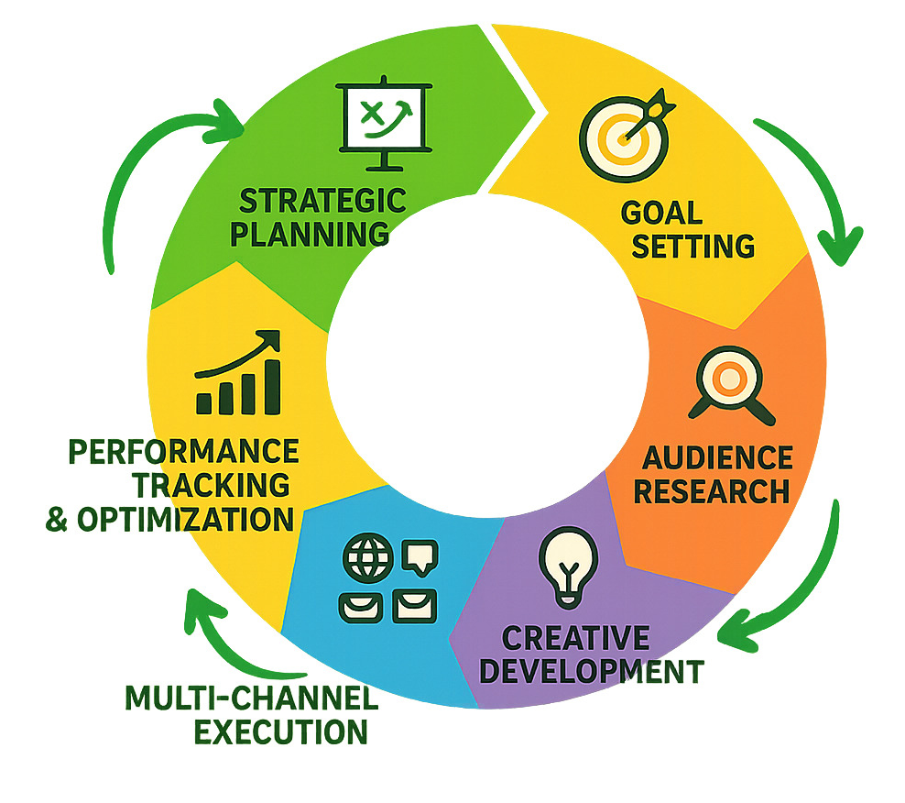
AD CAMPAIGN EFFECTIVENESS & OPTIMIZATION
Key Performance Indicators
Click-Through Rate (CTR)
Measures the percentage of impressions that result in clicks.
CTR = (Clicks / Impressions) × 100
Conversion Rate
Measures the percentage of clicks that result in a desired action.
Conversion Rate = (Conversions / Clicks) × 100
Cost Per Click (CPC)
Measures the average cost of generating a click.
CPC = Total Ad Spend / Clicks
Return on Ad Spend (ROAS)
Measures the revenue generated for every unit of advertising spend.
ROAS = Revenue Attributed to Ads / Advertising Spend
Optimization Strategy
  Compare campaign results across audience segments.
  Test different creatives, hashtags, and content formats.
  Allocate more budget to campaigns that meet performance targets.
  Monitor conversion and acquisition costs before increasing spend.

Slide 18
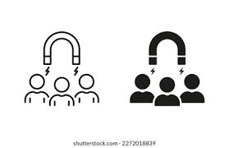
USER RETENTION & RE-ENGAGEMENT STRATEGY
Recommended Strategies
Personalized Notifications
  Recommend relevant posts and accounts.
  Remind inactive users about trending content.
Re-Engagement Campaigns
  Send personalized emails or app notifications.
  Use content suggestions based on users’ interests.
Posting Challenges
  Introduce weekly photo themes and creative challenges.
  Encourage users to share their first post or return to posting.
Incentives and Recognition
  Offer participation badges and rewards.
  Recognize users who return and become active again.
Success Metrics
Reactivation rate.
Number of posts from reactivated users.
Likes and comments after reactivation.
Retention over the following weeks.
Expected Outcome:
Increased participation, improved retention, and stronger community engagement.

Slide 19

PERSONALIZED RECOMMENDATIONS
Objective:
Use user-generated content to understand interests and improve content relevance.
Data Used
Photos posted by users.
Hashtags and photo tags.
Likes and comments.
User activity and interaction patterns.
Key Findings
  The dreamy tag has the highest average likes per photo in the current analysis.
  Other strong-performing tags include beauty, stunning, and delicious.
  Frequently used tags can help identify topics that interest particular users.

Slide 20

FUTURE RECOMMENDATIONS
Reward loyal and highly engaged users.
Re-engage inactive users through personalized campaigns.
Improve recommendations using hashtag and interaction data.
Collaborate with creators who demonstrate strong engagement.
Track retention and engagement metrics to evaluate future initiatives.
Measure advertising effectiveness when campaign data becomes available.

Slide 21

CONCLUSION
Summary of Insights:
Leverage mapped engagement patterns and user segmentation to launch high-precision, actionable campaigns.
Strategic Next Steps:
Establish clear instructional pathways and cross-functional collaborations to move from theory to practice.
Data-Driven Methodology:
Prioritize analytical decision-making to ensure our tactics remain responsive to shifting user behaviors and needs.
SQL-based analysis of user behavior can help transform raw social media data into actionable marketing insights. By combining user segmentation, engagement analysis, content performance, and targeted retention strategies, the platform can work toward improving participation, strengthening its creator community, and supporting data-driven marketing decisions.

Slide 22
THANK YOU

